Slide 1
Building Chatbots with
Watson Assistant (Workshop)
Sophia Ji Who Choi
(jwchoi@ibm.com)
Software Developer at IBM
Notes:
(50 seconds)

Slide 2
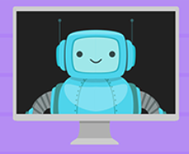
What is a chatbot?
Chatbots = bot + conversation
Also known as chatterbots, virtual assistant, talkbot, and Conversational Agent
A software agent able to have a conversation, interacting with the user by voice, text, images, and more

Slide 3
What are chatbots for?
Quickly answering the most common questions and requests for information
Provide immediate response
24/7 Availability
Reduces time and human errors
Notes:
human errors.

Slide 4
Let’s create a chatbot!

Slide 5
#1: Log into IBM Cloud.
#2: Click on the Create resource button on your dashboard.
#3: Search for Watson Assistant in the search field.

Slide 6
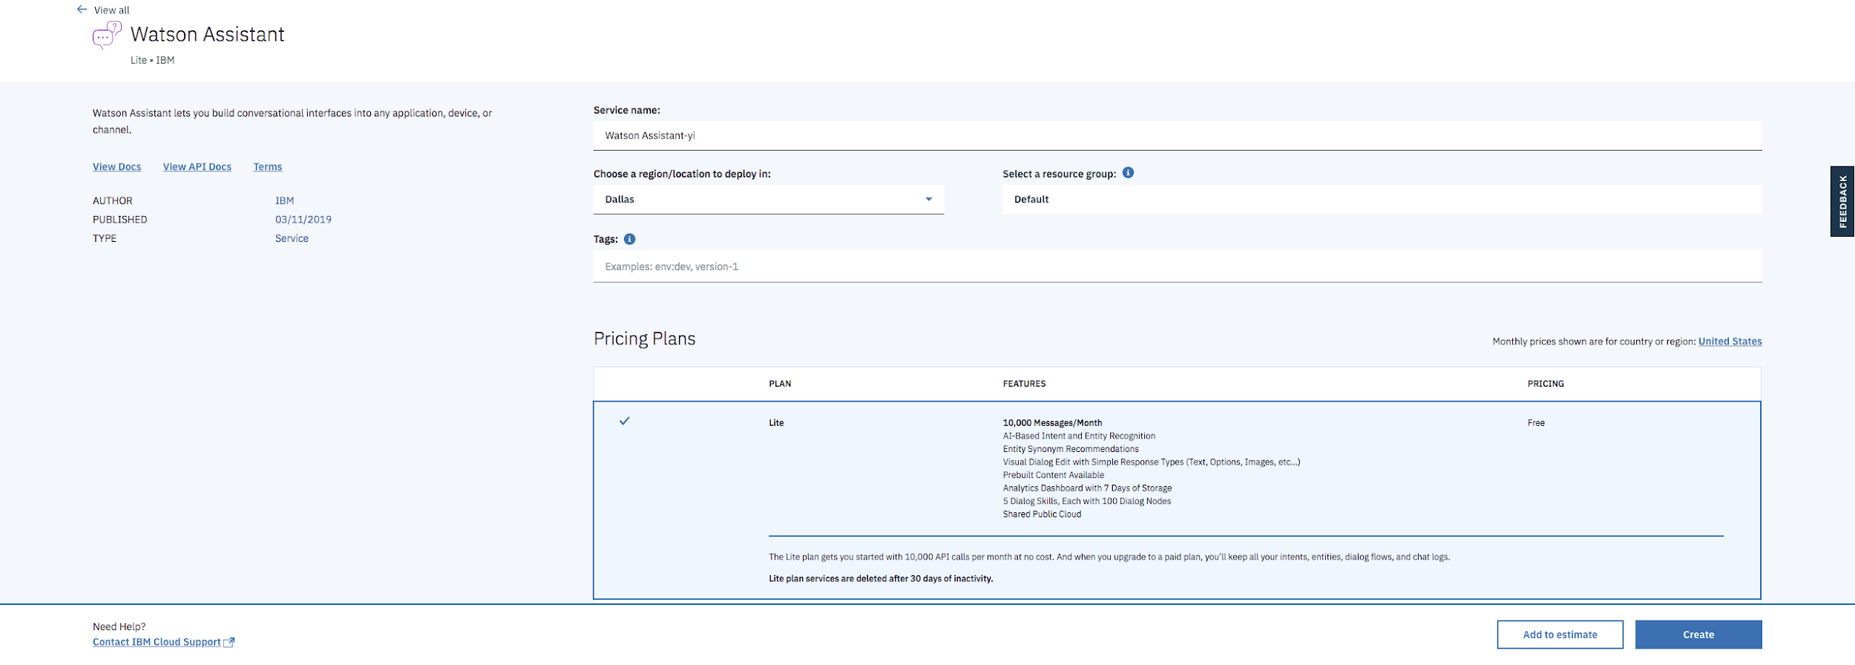
#4: Name your chatbot and click on the Create Button.

Slide 7
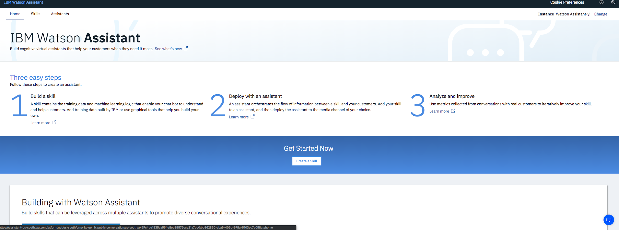
#4: Click on the Launch tool button.
#5. Click on the Skills menu on the top of the page.

Slide 8
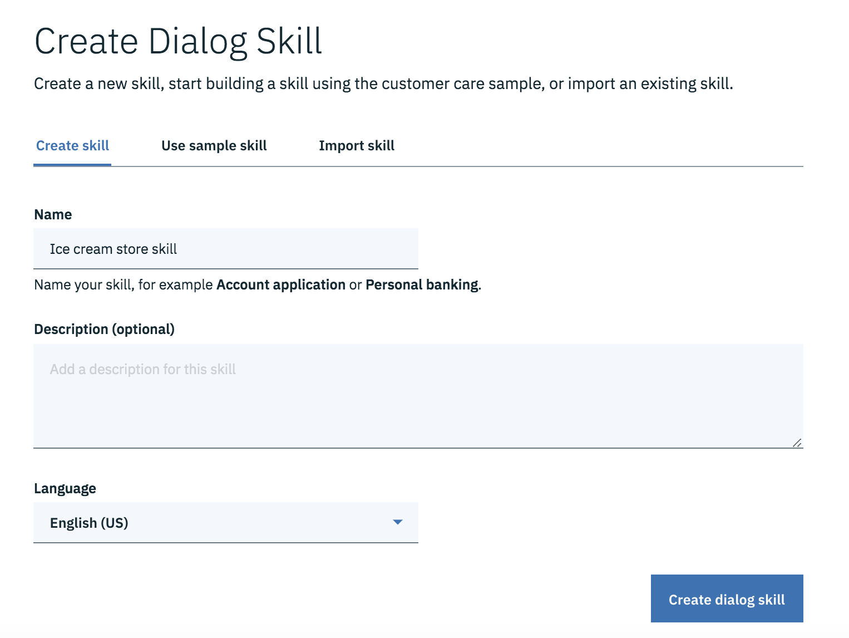
#6: Click on the Create Skill button.
#7: Enter a name and an optional Description.
#8: Click on the Create Dialog skill button to generate the skill.

Slide 9
Concept #1: Intents and Entities
An intent is the goal or purpose of the user’s message.
Examples:
#greetings with examples: [“hello”, “hi”, “hey”, “good morning”, “good afternoon”]
#hours_info with examples: [“When do you open”, “When are you open”, “Are you open on Saturdays?”, “What are your hours?”, “Are you open on Christmas' Day?” ]
An entity is a value of the user’s input that you can use to provide different responses to a particular intent.
Examples:
@locations with examples: [“Toronto” with synonyms (“The 6ix”, “Queen City”)]
@types_ice_creams with examples: [“sundae“, “sandwich”, “ice cream cake”, ““popsicle”, “gelato”]

Slide 10
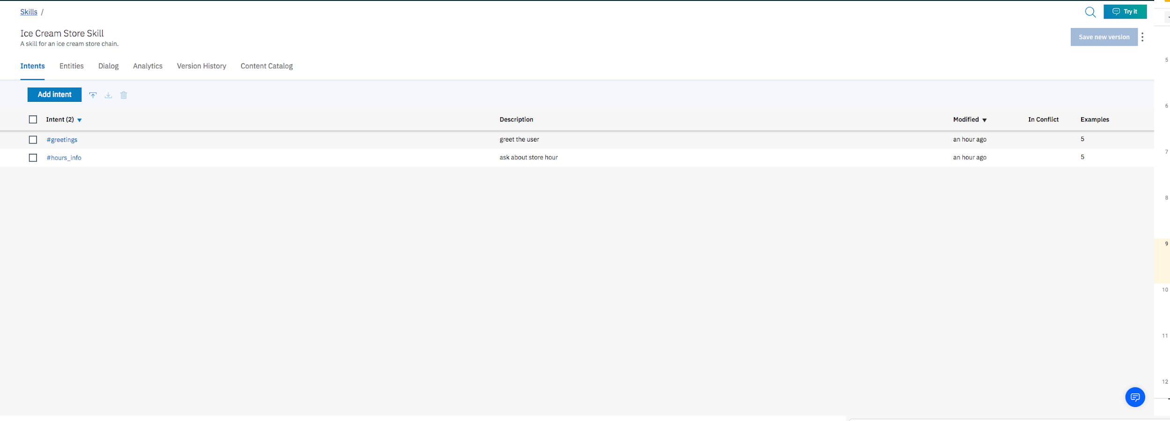
Let’s try it out!

Slide 11
Concept #2: Simple Dialogs
Dialog uses intents and entities to define a response to each user’s input. It defines how your chatbot will respond to what users are saying.
Example:
Default welcome response: “Hello. My name is Watson and I'm a chatbot. How can I help you? You can ask me about our store hours.”
If the chatbot recognizes #hours_info intent, respond to the user: “We are open to 10 AM to 5 PM from Monday to Friday.

Slide 12

Let’s respond to hours of operation intent

Slide 13
Concept #2: Conditional Dialogs
What if we want to give a specific response based on entities.
Example:
: “Could you recommend me sundae? ”
The chatbot will recognize #ice_cream_suggestion and @ice_cream_type:sundae, respond to the user: “Our best selling sundae is caramel drizzle sundae”.
Notes:
If the node has children nodes, the execution continues with its children.

Slide 14
Let’s generate your WordPress website!

Slide 15
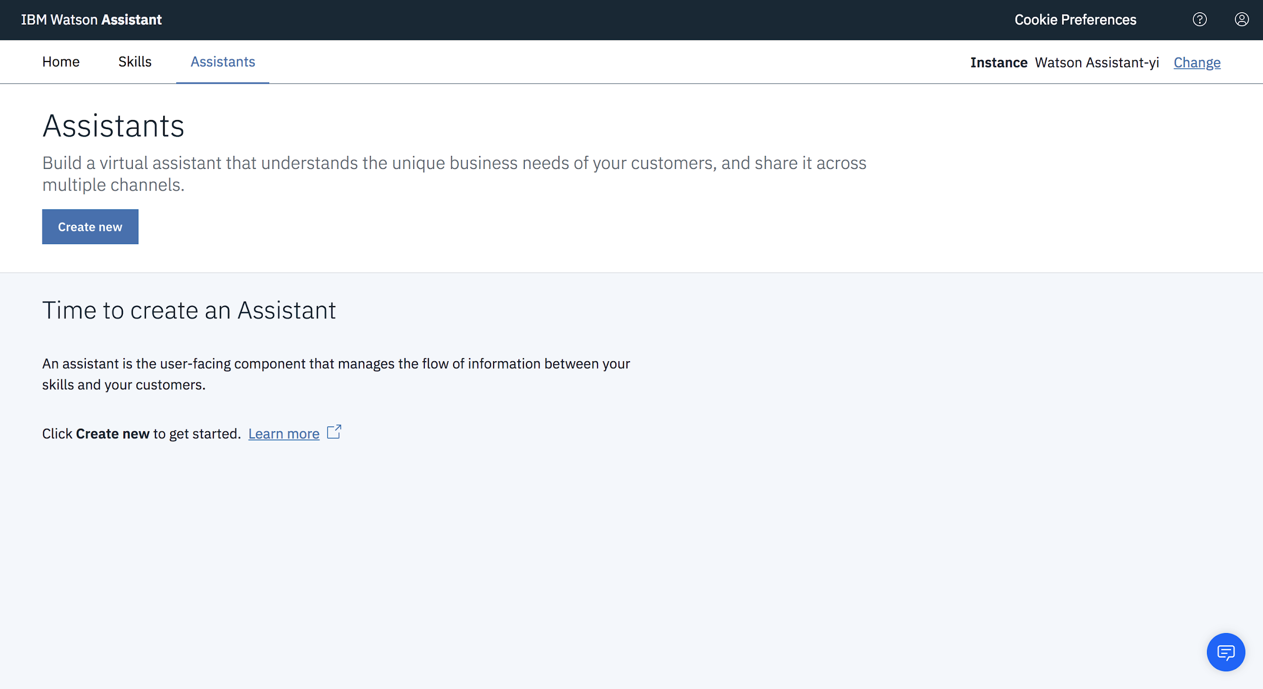
Let’s deploy your chatbot to your website!

Slide 16
#1: Click Add Dialog Skill.
#2: Select Add existing skill.

Slide 17
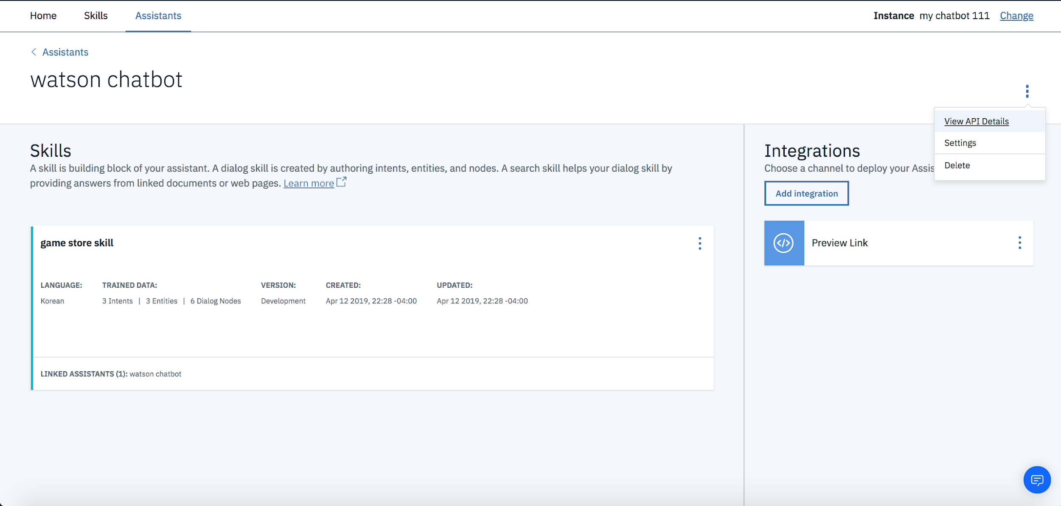
#3: Click on the View API Details link.
#4: Save the Assistant URL, username, and Password

Slide 18
#5: Visit your WordPress Dashboard.
#6: Press the Log In button with Username and Password.
#7: Click on Plugins in the sidebar.
#8: Click Activate under the Watson Assistant plugin.

Slide 19
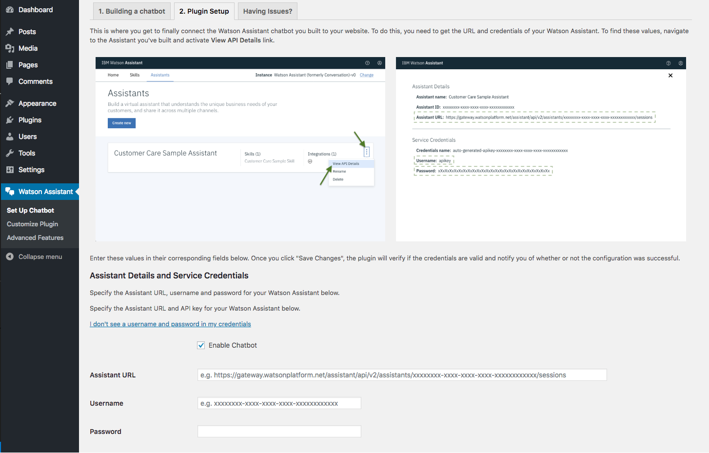
#9: Copy and Paste Assistant URL, Username, and Password.

Slide 20
Let’s check our website!
You can also customize your website with images and texts

